Slide 1
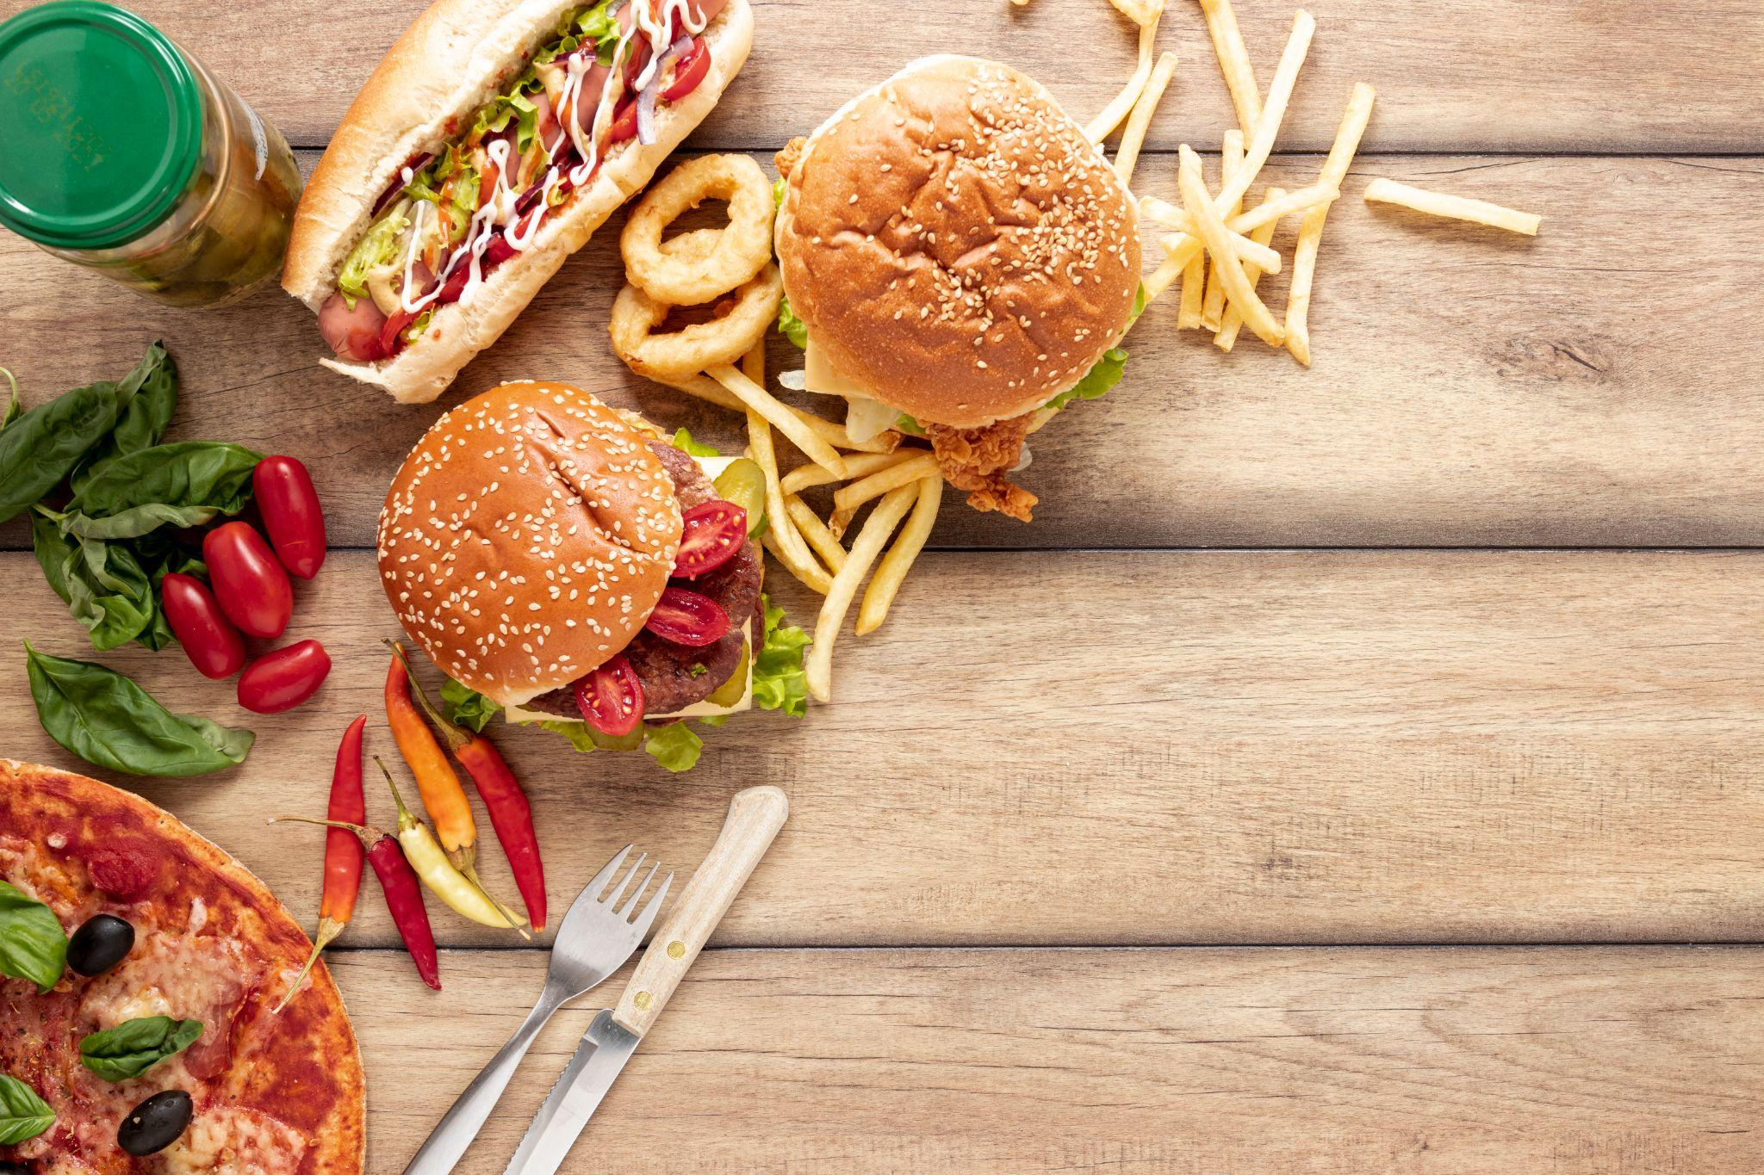
Uber
Eats
Team 2: Abhi Jindal, George Ding,
Tanya Chhabra, Yiheng Chen, Junqi Fang

Slide 2

Project Overview
This project analyzes the Uber Eats USA Restaurants & Menus dataset to uncover trends in cuisine preferences, menu pricing, and restaurant distribution across the United States.
Using Python and visualization tools, we performed data cleaning, exploratory data analysis, and visual storytelling to identify dominant cuisines, pricing patterns, and potential white-space opportunities for restaurant expansion.
Our insights aim to inform data-driven decisions for restaurants and delivery platforms to optimize pricing strategies, menu offerings, and regional market entry plans.

Slide 3
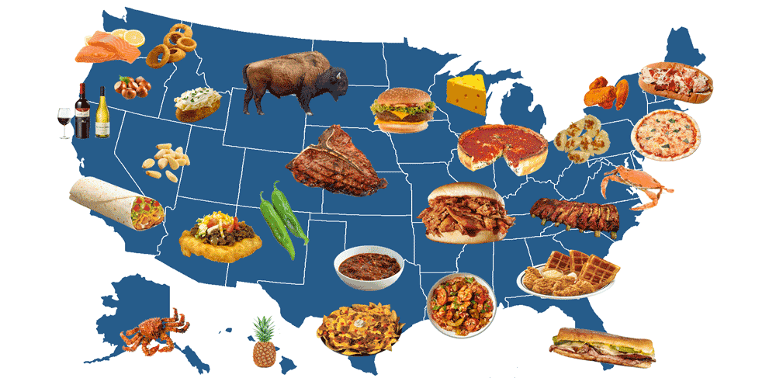
Restaurant Density Across U.S.
Texas has nearly 30,000 restaurants and is a crucial hub in the food industry.
In Virginia, Washington State, and
some areas of the Midwest, the density of restaurants is at a moderate level.
The gradual change in color clearly highlights the differences between
Texas and the rest of the US
Graph 1

Slide 4
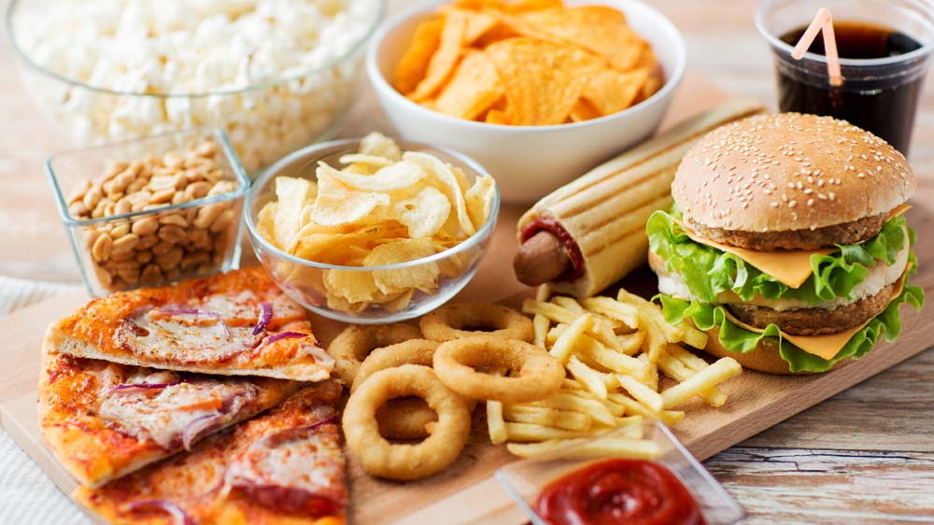
Market Share of Top 10 cuisines
35.2% - Market share of American cuisine
14.7% - Mexican cuisine, an important part of the American food industry
12.9% -Hamburger, one of the favorite foods among Americans
Pizza, breakfast and brunch each account for 8.9%, 5.3% respectively.
Chinese cuisine, Asian cuisine, desserts
and fast food each around for 4-5%
Graph 2

Slide 5
Spread of American Cuisine, Price Range & Rating
1. Geographic Concentration
Larger, more diverse states show stronger markets, while smaller ones have fewer restaurants.
2. Price & Rating Patterns
Most restaurants fall in low to mid-price ranges
High-priced restaurants are rare and don’t necessarily earn higher ratings
Mid-priced venues often achieve more stable and higher customer satisfaction
American cuisine is widespread in large states, and value-for-money balance is the main driver of positive ratings.
Graph 3a
Graph 3b

Slide 6

Economic Influence on Premium Dining Patterns
What NEXT?
How to predict NEXT?
What is the difference between different states market?
If we want to run a new restaurant, what shall we DO?
Graph 4

Slide 7
Conclusion
The analysis of the Uber Eats restaurant and menu data establishes that the US food delivery market is in a dual-market equilibrium. This structure consists of a low-margin, high-volume center and a low-volume, high-margin periphery.
Market Concentration and Dynamics: This concentration is a points to an extremely mature and competitive market segment where success is driven by operational efficiency and product differentiation rather than market entry per se.
Pricing Strategy and Revenue Maximization: The data, most significantly, points towards enormous untapped potential in premium niche categories.
Customer Value Proposition: One of the findings from customer ratings analysis is a universal truth about consumer behavior: relative value, not absolute price, is a stronger determinant of satisfaction.
L

Slide 8
Limitations
The Missing Ratings Problem - Our biggest data risk was that roughly 23% of restaurants had no rating data.
Homogeneity Risk - Cuisine categorization is too simple and it underestimating the true diversity of the market.
No Sales Data - The dataset lacked essential transactional data like sales volume, order frequency, or basket size. This is a critical limitation because we can observe pricing power (what restaurants charge), but we cannot definitively calculate the price elasticity of demand.

Slide 9
Future Steps & Recommendations
Project-oriented methodological enhancements and business-oriented strategic initiatives to translate insights into measurable market action:
Dynamic Pricing Model Integration
Advanced Geospatial Segmentation
NLP for Menu Item Analysis
Tiered Market Expansion Strategy
Achieving Quality Excellence
Localized Marketing and Service Protocols

Slide 10



Thank You
Questions & Feedback

Slide 11

Thank You
Questions & Feedback

